Slide 1
Effective Java - Concurrency
fli@telenav.cn

Slide 2
The scope of the topic
Concurrency
Distributed
Parallel
Multiply-Thread
Multiply-Core
Multiply-Box (Process/JVM)

Slide 3
The scope of the topic
Concurrency
….
Scala
Erlang
java
CSP
Multiply-Thread Programming in java

Slide 4
Outline
Warm-up
Counter
What’s concurrency programming
Shared Data/Coordination : safe(correctness)
Performance : scalability
After JDK5 concurrency
Lock
Synchronizers
Executor/Concurrent Collections/ Atomic
Why it’s hard
Java Memory Model

Slide 5
Warm-up
Counter
@NotThreadSafe
public class Counter {
private int count = 0; //shared data
public void increment() {
count++;
}
public int getCount() {
return count;
}
}
Thread A: Retrieve c =0 .
Thread B: Retrieve c = 0 .
Thread A: Increment retrieved value; result is 1.
Thread B: Increment retrieved value; result is 1.
Thread A: Store result in c; c is now 1.
Thread B: Store result in c; c is now 1.

Slide 6
Warm-up
Counter
@NotThreadSafe
public class Counter {
private int count = 0; //shared data
public synchronized void increment() {//write protected by lock
count++;
}
public int getCount() {
return count;
}
}

Slide 7
Warm-up
Counter
@ThreadSafe
public class Counter {
private int count = 0; //shared data
public synchronized void increment() {
count++;
}
public synchronized int getCount() {
return count;
}
}
get need to be synchronized for the class to be thread-safe,
to ensure that no updates are lost,and that all threads see
the most recent value of the counter. (Visibility)

Slide 8
Warm-up
Counter
@ThreadSafe
public class Counter {
private volatile int count = 0; //shared data
public synchronized void increment() {
count++;
}
public int getCount() {
return count;
}
}
uses volatile to guarantee the visibility of the current result
where locks(synchronzied)only allow one thread to access a value at once,
volatile reads allow more than one, you get a higher degree of sharing

Slide 9
What’s concurrency programming
Why concurrency (purpose)
Multitasking, Exploit multiple cores or CPUs
Multi-threading good for blocking for I/O or other blocking ops
Concurrency programming
Shared Data between threads
Coordination between threads
Avoid performance even poor than non-concurrent program

Slide 10
What’s concurrency programming
Shared Data
Lock/Mutual
Atomicity
Visibility
Safe Publication
Coordination
Wait/Notify
Performance(scalable)
Lock contention

Slide 11
What’s concurrency programming
Atomicity
Check-then-act
Read-modify-write
if (foo != null) // Another thread could set foo to null
foo.doSomething();
synchronized
ConcurrentHashMap.putIfAbsent
lock
++numRequests; // Really three separate actions even if volatile
synchronized
AtomicInteger.getAndSet
cmpxchgl

Slide 12
What’s concurrency programming
Visibility
Never-Stop Thread, windows JDK6: java –server StopThread
@NotThreadSafe
public class StopThread
{
private static boolean stopRequested;
public static void main(String[] args) throws InterruptedException
{
Thread backgroudThread = new Thread(new Runnable() {
public void run()
{
int i = 0;
while (!stopRequested)
i++;
}
});
backgroudThread.start();
TimeUnit.SECONDS.sleep(1);
stopRequested = true;
}
}
//Compiler Optimization
if (!stopRequested)
while(true)
i++;

Slide 13
What’s concurrency programming
Visibility
@ThreadSafe
public class StopThread
{
private static volatile boolean stopRequested;
public static void main(String[] args) throws InterruptedException
{
Thread backgroundThread = new Thread(new Runnable() {
public void run()
{
int i = 0;
while (!stopRequested)
i++;
}
});
backgroundThread.start();
TimeUnit.SECONDS.sleep(1);
stopRequested = true;
}
}
What’s volatile ?

Slide 14
What’s concurrency programming
Visibility : volatile
JLS 8.3.1.4 volatile Fields
A field may be declared volatile, in which case the Java memory model (§17)
ensures that all threads see a consistent value for the variable.
JLS 17.4.4 Synchronization Order
A write to a volatile variable (§8.3.1.4) v synchronizes-with all subsequent reads of v by any thread (where subsequent is defined according to the synchronization order).
JLS 17.4.5 Happens-before Order
If one action happens-before another, then the first is visible to and ordered before the second.
If an action x synchronizes-with a following action y, then we also have hb(x, y).
Under Hook: Memory Barrier
Notes:
http://java.sun.com/docs/books/jls/third_edition/

Slide 15
What’s concurrency programming
Safe Publication : final
class FinalFieldExample {
final int x;
int y;
static FinalFieldExample f;
public FinalFieldExample(){
x = 3;
y = 4;
}
static void writer() {
f = new FinalFieldExample();
}
static void reader() {
if (f != null) {
int i = f.x; // guaranteed to see 3
int j = f.y; // could see 0
}
}
...
}
Re-order
it's quite natural to store a pointer to a block of memory, and then advance the pointer as you're writing data to that block
Notes:
Re-produce

Slide 16
What’s concurrency programming
Safe Publication : final
class FinalFieldExample {
final int x;
int y;
static FinalFieldExample f;
public FinalFieldExample(){
x = 3;
y = 4;
}
static void writer() {
f = new FinalFieldExample();
}
static void reader() {
if (f != null) {
int i = f.x; // guaranteed to see 3
int j = f.y; // could see 0
}
}
...
}
Allocate Memory
Allocate Memory
Filed initiation
Filed initiation
Execute Constructor
Assign variable
Assign variable
Execute Constructor
Single-Thread, re-order does not matter
Thread1.writer() //the java statement is finished
Thread1.reader()
If Multiply-Thread, re-order may be the evil
Thread1.writer() Thread2.reader()

Slide 17
What’s concurrency programming
Safe Publication : final
class FinalFieldExample {
final int x;
int y;
static FinalFieldExample f;
public FinalFieldExample(){
x = 3;
y = 4;
}
static void writer() {
f = new FinalFieldExample();
}
static void reader() {
if (f != null) {
int i = f.x; // guaranteed to see 3
int j = f.y; // could see 0
}
}
...
}
What’s final ?

Slide 18
What’s concurrency programming
Safe Publication : final
JLS 8.3.1.2 final Fields
A blank final instance variable must be definitely assigned (§16.9) at the end
of every constructor (§8.8) of the class in which it is declared;
otherwise a compile-time error occurs.
17.5.1 Semantics of Final Fields
The semantics for final fields are as follows. Let o be an object, and c be a constructor for o in which f is written. A freeze action on a final field f of o takes place when c exits, either normally or abruptly.
JLS 17.5.3 Subsequent Modification of Final Fields
An implementation may provide a way to execute a block of code in a final field safe context. If an object is constructed within a final field safe context, the reads of a final field of that object will not be reordered with modifications of that final field that occur within that final field safe context.

Slide 19
What’s concurrency programming
Safe Publication : Double-Checked Locking
// Broken multithreaded version "Double-Checked Locking" idiom
class Foo {
private Helper helper = null;
public Helper getHelper() {
if (helper == null)
synchronized(this) {
if (helper == null)
helper = new Helper();
}
return helper;
}
// other functions and members...
}
Notes:
http://www.cs.umd.edu/~pugh/java/memoryModel/DoubleCheckedLocking.html

Slide 20
What’s concurrency programming
Safe Publication : Double-Checked Locking
@ThreadSafe
class Foo {
private volatile Helper helper = null;
public Helper getHelper() {
if (helper == null)
synchronized(this) {
if (helper == null)
helper = new Helper();
}
return helper;
}
// other functions and members...
}

Slide 21
What’s concurrency programming
Safe Publication : Double-Checked Locking
@ThreadSafe // use class initialization
class HelperSingleton {
static Helper singleton = new Helper();
}
@ThreadSafe // Lazy load
class Foo {
private static class HelperHolder {
public static Helper helper = new Helper();
}
public static Helper getHelper() {
return HelperHolder.helper;
}
}

Slide 22
What’s concurrency programming
Safe Publication : Double-Checked Locking
@ThreadSafe
class Foo {
private volatile Helper helper = null;
public Helper getHelper() {
Helper result = helper; //local variable, for better performance
if (result == null) {
synchronized(this) {
result = helper;
if (result == null) {
helper = result = new Helper();
}
}
}
return result;
}
// other functions and members...
}
Variant of DDL, each has it’s own standard point

Slide 23
What’s concurrency programming
Safe Publication
public class Cache {
private final Thread cleanerThread;
public Cache() {
cleanerThread = new Thread(new Cleaner(this)); // this escapes again!
cleanerThread.start();
// ….
}
// Clean will call back to this method
public void cleanup() { // clean up Cache }
}
//Careful progmramming
@ThreadSafe
public Cache() {
cleanerThread = new Thread(new Cleaner(this);
// ….
cleanerThread.start(); //last statement
}
}
//FactoryMethod Pattern
@ThreadSafe
public class Cache {
// ...
public static Cache newCache() {
Cache cache = new Cache();
cache.startCleanerThread();
return cache;
}
}
More safely published method (see book JCIP)
Notes:
http://stackoverflow.com/questions/801993/java-multi-threading-safe-publication

Slide 24
What’s concurrency programming
Cooperation: Object.wait and notify
//Standard Idiom for using the wait method
final Object obj = new Object(); // Do not change your lock object refrence
//Thread 1
synchronized(obj) { // You must synchronize.
while(! someCondition()) // Always wait in a loop.
{
obj.wait(); //Release lock, and reacquires on wakeup
}
}
// Thread 2
synchronized(obj) { // Synchronize here too!
satisfyCondition();
obj.notifyAll();
}

Slide 25
What’s concurrency programming
Performance
Lock contention
Multiply-Thread acquires and wait for 1 lock
Starvation
DeadLock /LiveLock
DeadLock : both are waiting the other to release resources
LiveLock : both are run-able and no one make progress
Spin Lock
Check and Sleep, wasting cpu cycle
Reduce Lock contention
Use local variables or thread-local storage (Careful → memory leak)
Get rid of expensive calculations while in locks
Lock striping (ConcurrentHashMap)
atomic operations/
Reader-Writer Locks
Avoid Object-pooling (Object-creation is expensive)
Avoid hotspots
Notes:
http://www.thinkingparallel.com/2007/07/31/10-ways-to-reduce-lock-contention-in-threaded-programs/

Slide 26
JDK5 Concurrency
Lock
Java provides basic locking via synchronized
Good for many situations, but some issues
Single monitor per object (single wait/notify condition)
Not possible to interrupt thread waiting for lock
Not possible to time-out when waiting for a lock
Block structured approach
Acquiring multiple locks is complex
Advanced techniques not possible
New Lock interface addresses these issues
synchronized
Acquire_Lock_1
Acquire_Lock_2
Release_Lock_2
Release_Lock_1
Lock
Acquire_Lock_1
Acquire_Lock_2
Release_Lock_1
Release_Lock_2

Slide 27
JDK5 Concurrency
Lock
void | lock() Acquires the lock.
void | lockInterruptibly() Acquires the lock unless the current thread is interrupted.
Condition | newCondition() Returns a new Condition instance that is bound to this Lock instance.
boolean | tryLock() Acquires the lock only if it is free at the time of invocation.
boolean | tryLock(long time, TimeUnit unit) Acquires the lock if it is free within the given waiting time and the current thread has not been interrupted.
void | unlock() Releases the lock.

Slide 28
JDK5 Concurrency
ReentrantLock
Rentrant means lock holder reacquire the lock: e.g recur method
ReentrantReadWriteLock
Lock downgrading. Upgrading is not allowed
Release read lock first , acquire write lock
Writer starvation ?
Lock l = new ReentrantLock();
l.lock();
try {
// access the resource protected by this lock
}
finally {
l.unlock();
}
Notes:
http://java.dzone.com/news/reentrantlock-and-dining-philo
http://www.javaspecialists.eu/archive/Issue165.html

Slide 29
JDK5 Concurrency
Condition (Object.wait and notify in explicit lock)
private final Lock lock = new ReentrantLock();
private final Condition condition = lock.newCondition();
public void waitTillChange() {
lock.lock();
try {
while(! someCondition()) condition.await();
} finally {
lock.unlock();
}
}
public void change() {
lock.lock();
try {
satisfyCondition();
condition.signalAll();
} finally {
lock.unlock();
}
}

Slide 30
JDK5 Concurrency
Synchronizers (Higher-level concurrency utilities to Object.wait and notify)
Semaphore
CountDownLatch
Spawn sub-worker and wait for sub-worker
E.g getAds, spawn 3 worker to get ads from different vendor
getAdsFromCitySearch
getAdsFromGoogle
getAdsFromTeleNav
CyclicBarrier
Exchanger
Phaser (1.7)
ForkJoinPool (1.7)

Slide 31
JDK5 Concurrency
Executor/Concurrent Collections/ Atomic
BlockingQueue (producer-consumer queues)
 | Throws exception | Special value | Blocks | Times out
Insert | add(e) | offer(e) | put(e) | offer(e, time, unit)
Remove | remove() | poll() | take() | poll(time, unit)
Examine | element() | peek() | not applicable | not applicable
A lot of things are not covered today, worth to explore and use …

Slide 32
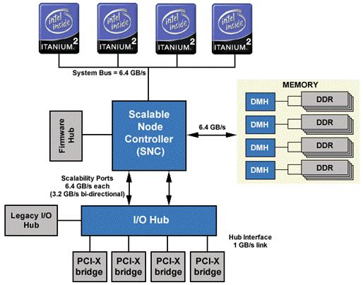
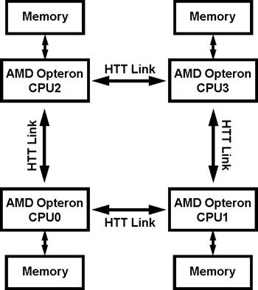
Why it’s hard
The “evil”
Cache Coherency
Processor /Memory
A CPU does not always fetch memory values from RAM
Processor/Processor
Reordering
Processor : rearrange the execution order of machine instructions
Compiler Optimizations : rearrange the order of the statement
Memory : rearrange the order in which writes are committed to memory cells
Cache-Coherency

Slide 33
Why it’s hard
Ordering
within-thread
From the point of view of the thread performing the actions in a method, instructions proceed in the normal as-if-serial manner that applies in sequential programming languages.
between-thread
From the point of view of other threads that might be "spying" on this thread by concurrently running unsynchronized methods, almost anything can happen. The only useful constraint is that the relative orderings of synchronized methods and blocks, as well as operations on volatile fields, are always preserved
Notes:
http://gee.cs.oswego.edu/dl/cpj/jmm.html

Slide 34
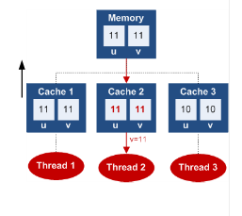
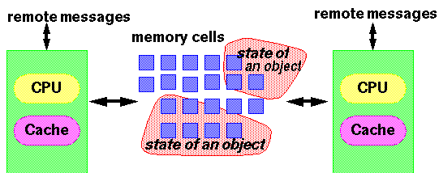
Why it’s hard
Java Memory Model
address three intertwined issues
Atomicity
Visibility
Ordering
Notation
Program orders (Intra-Thread)
Synchronize-with
Happen-Before (HB)
synchronized
volatile
final

Slide 35


Slide 36
References
http://www.slideshare.net/sjlee0/robust-and-scalable-concurrent-programming-lesson-from-the-trenches
http://www.slideshare.net/caroljmcdonald/java-concurrency-memory-model-and-trends-4961797
http://www.slideshare.net/alexmiller/java-concurrency-gotchas-3666977
Effective Java

